Slide 1

Password Protected Secret Sharing
Presenter:
Joan Ngure

Slide 2
Outline
1. Definition of shamir’s secret sharing
2. Elgamal Public Key Encryption
3. What is password protected secret sharing
4. Explain a password protected secret sharing scheme
5. Attacks and why it should be secure against offline attacks
6. Suggested improvements

Slide 3
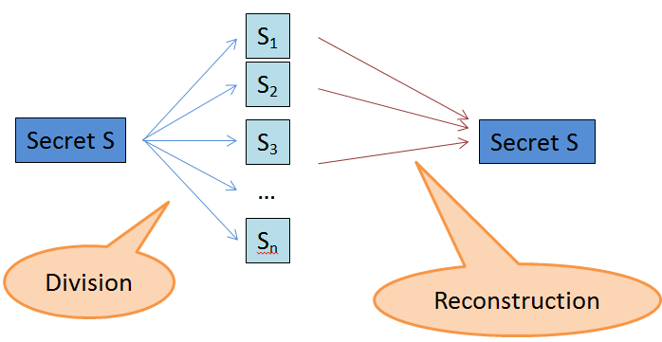
Secret sharing scheme
Notes:
Two algorithms: share and reconstruction.

Slide 4
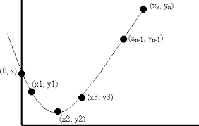

SSS Algorithm
$$f\left(x\right)=s+a_{1}x+a_{2}x^{2}+⋯+a_{n}x^{n−1}$$
xi = Public Identity
$Y_{i}$= Secret Share
$f\left(x\right)∈Z_{p}$
Notes:
Lagrange interpolation

Slide 5


SSS Properties
1. Correctness
$\underset{share\left(s \right)→(s_{1}, ⋯, s_{n})}{Pr}\left[Reconstruct\left(s_{1}, ⋯, s_{t}\right)=s\right]=1$
2. Perfect Secrecy
Pr$(s|s_{1},⋯,s_{t−1}) =Pr⁡(s)$
Notes:
t-1 or less shares do not leak any information about the secret. t shares (semi-honest) always reconstruct the correct secret. The adversary can only corrupt upto t-1 shares.

Slide 6
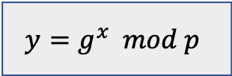
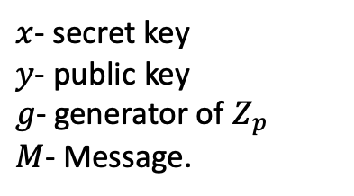
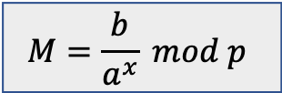
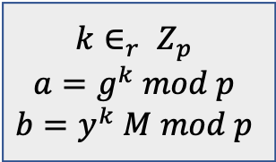

ElGamal Public Key Encryption
Alice
Bob
$$y, p,g$$
$$k∈_{r} Z_{p}$$
$$a=g^{k} mod p$$
$$b=y^{k} M mod p$$
$$y=g^{x} mod p$$
a , b
$$M=\frac{b}{a^{x}} mod p$$
$x$- secret key
$y$- public key
$g$- generator of $Z_{p}$
$M$- Message.
Notes:
We have a cyclic group $Z_{p}$ with a generator $g.$

Slide 7
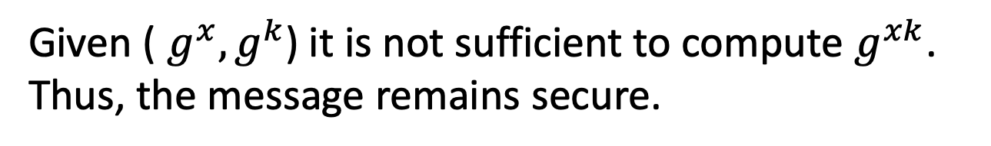
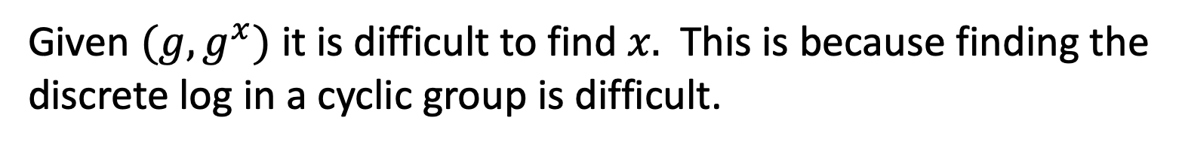
Security Properties of ElGamal PKE
The message is masked by multiplying it with $g^{xk}$.
Given $(g,g^{x})$ it is difficult to find $x.$ This is because finding the discrete log in a cyclic group is difficult.
Given ( $g^{x},g^{k}$) it is not sufficient to compute $g^{xk}$. Thus, the message remains secure.
Notes:
Similar to Diffie-hellman key exchange. $\log_{g}{g^{x}=x}$

Slide 8

Password Protected Secret Sharing
Alice has some secret data which she wishes to protect.
Her device would get stolen or fall prey of some malware, which could expose her data.
She would also like to access her data from more than one device using a password.

Slide 9



Password Protected Secret Sharing Cont’
$s_{1}$
To access the shares, a password is required.
$s_{2}$
N passwords are hard to remember..
Secret
Using only a single password on n servers isn’t secure.
$s_{n}$
Notes:
Alice can distribute her data among n servers and use n passwords to protect it or one password for all the servers. How can Alice share her secret data and trigger the reconstruction process using her password?

Slide 10
Security Properties
1. Alice can recover her secret data upon entering her password in the reconstruction protocol, as long a t uncorrupted servers are accessible.
2. An adversary corrupting t servers without the knowledge of the password does not learn anything useful about the secret.

Slide 11
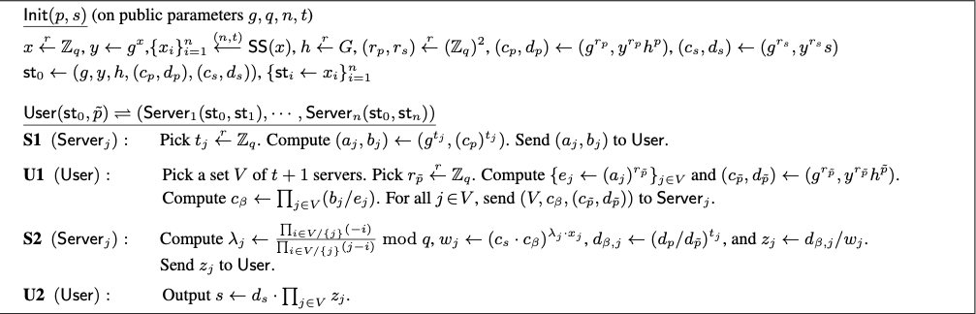
The Scheme - Semi Honest Case
Notes:
This scheme combines both secret sharing and ElGamal public key encryption. It has the security properties of both. In this protocol, a secret $s$ is encrypted using the Elgamal scheme. The private key $x$of the Elgamal scheme is shared using a $(t,n)$ threshold secret sharing scheme. However, to reconstruct the secret a password $p$, is be used. The password is encrypted as follows: $\left(c_{p},d_{p}\right)←(g_{,}^{r_{p}} , y^{r_{p}}h^{p})$ and the values $\left(c_{p},d_{p}\right)$published publicly. The reconstruction protocol involves a 3-way engagement between the user and the servers. When the user contacts the servers, the servers respond with randomized values of the password encryption. The user then performs some computations on these values using the password and sends the results to the servers. Using these results, each server performs a partial decryption of $s$ using their share of $x$ and sends it to the user. The user combines these partial decryptions to recover $s$. $s$ is only correctly recovered if the user used the correct password to perform the computations.

Slide 12
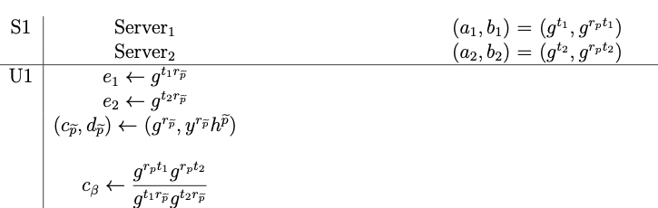
Case: (2,n) Secret Sharing Scheme

Slide 13
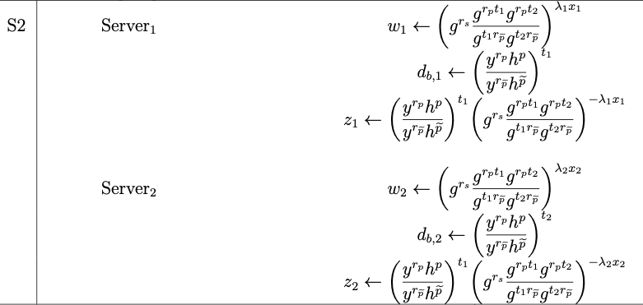
Notes:
The list of the servers present is provide to the servers by the user.

Slide 14
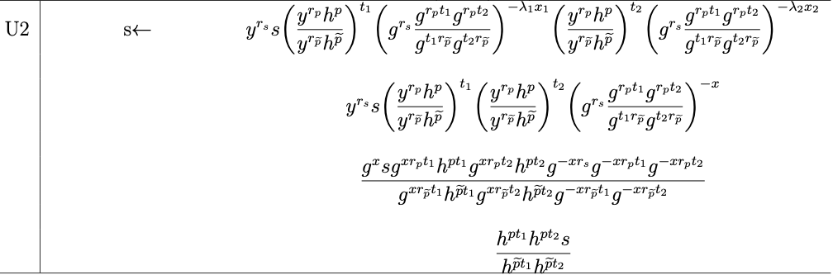
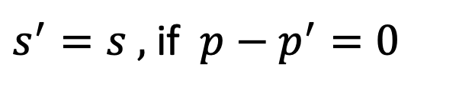
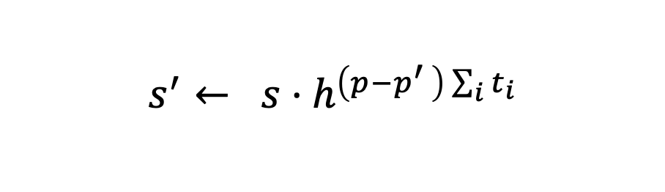
$$s^{′}← s⋅h^{\left(p−p^{′ }\right)\sum_{i}{t_{i}}}$$
$s^{′}=s ,$ if $p−p^{′}=0$

Slide 15
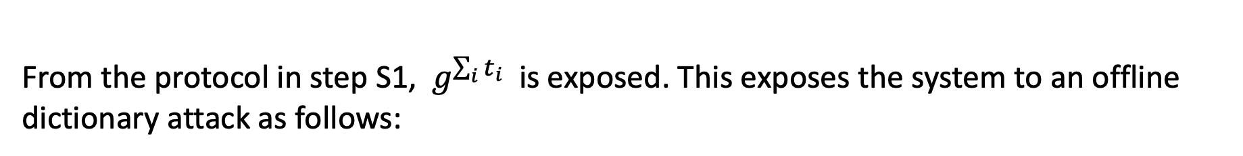
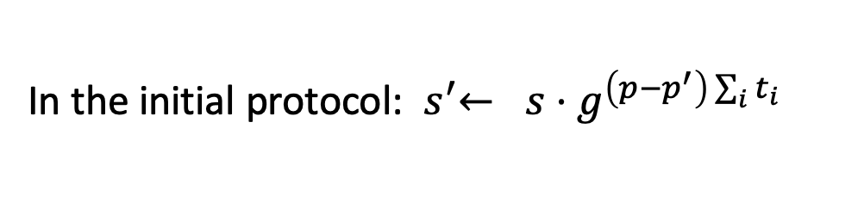
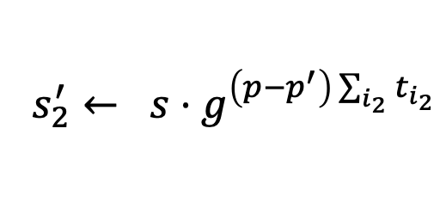
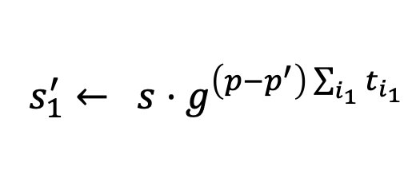

Prevents offline dictionary attack
In the initial protocol: ${ s}^{′}← s⋅g^{\left(p−p^{′}\right)\sum_{i}{t_{i}}}$
From the protocol in step S1, $g^{\sum_{i}{t_{i}}}$is exposed. This exposes the system to an offline dictionary attack as follows:
Take an adversary who runs the protocol twice while keeping $p^{′}$constant:

Slide 16
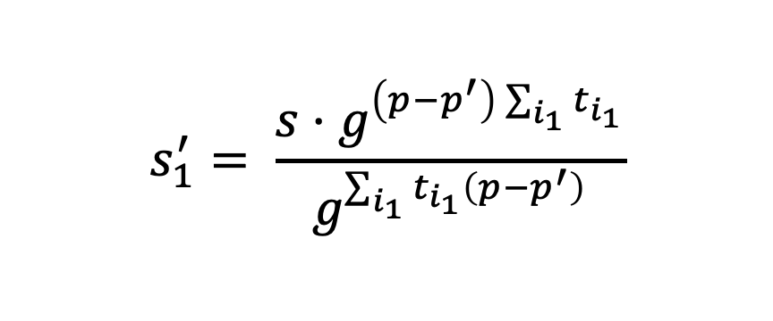

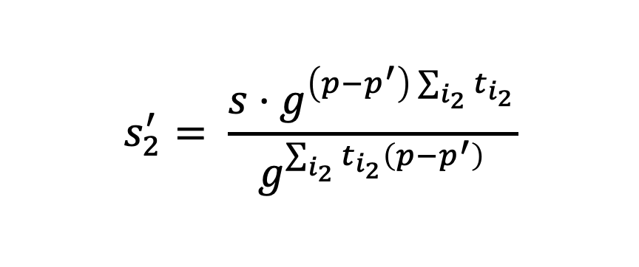
Look for a $p$ such that $s_{1}^{′}=s_{2}^{′}$
$$s_{1}^{′}= \frac{s⋅g^{\left(p−p^{′}\right)\sum_{i_{1}}{t_{i_{1}}}}}{g^{\sum_{i_{1}}{t_{i_{1}}\left(p−p^{′}\right)}}}$$
$$s_{2}^{′}= \frac{s⋅g^{\left(p−p^{′}\right)\sum_{i_{2}}{t_{i_{2}}}}}{g^{\sum_{i_{2}}{t_{i_{2}}\left(p−p^{′}\right)}}}$$
Using $h^{p}$ instead of $g^{p}$ protects the protocol from such an attack.

Slide 17
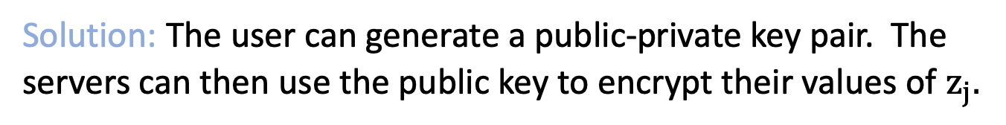

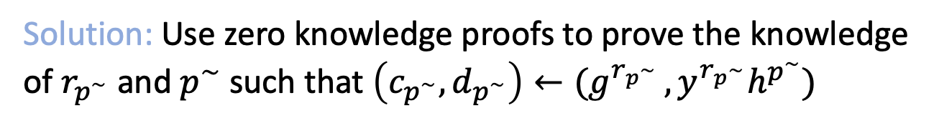
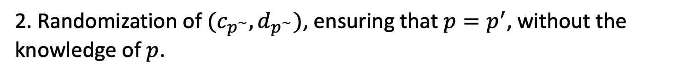
Attacks
1. Eavesdropping on $z_{j}′s$.
Solution: The user can generate a public-private key pair. The servers can then use the public key to encrypt their values of $z_{j}.$
2. Randomization of $(c_{p^{\sim }},d_{p^{\sim }})$, ensuring that $p=p^{′}$, without the knowledge of $p$.
Solution: Use zero knowledge proofs to prove the knowledge of $r_{p^{\sim }}$ and $p^{\sim }$ such that $\left(c_{p^{\sim }},d_{p^{\sim }}\right)←(g^{r_{p^{\sim }} }, y^{r_{p^{\sim }}}h^{p^{\sim }})$

Slide 18
Suggested Improvements
1. Password update.
2. Secret key share updates.
Notes:
Forward secrecy. Updating the password and the secret key shares. Addition of two polynomials with one having the constant term zero.

Slide 19
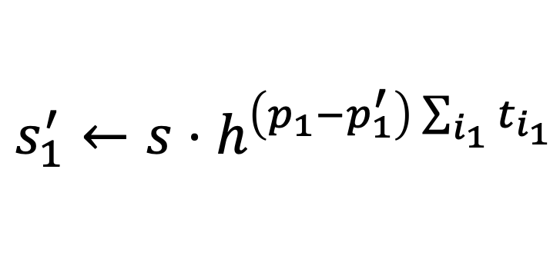
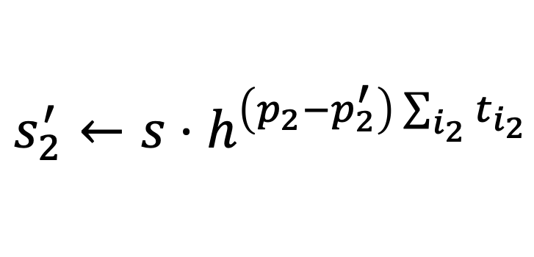
Password Update
At time t = 1:
$${s_{1}^{′}←s⋅h}^{\left(p_{1}−p_{1}^{′}\right)\sum_{i_{1}}{t_{i_{1}}}}$$
At time t = 2:
$${s_{2}^{′}←s⋅h}^{\left(p_{2}−p_{2}^{′}\right)\sum_{i_{2}}{t_{i_{2}}}}$$
Notes:
After a password update, even thou the previous password is exposed, the secret remains secure.

Slide 20
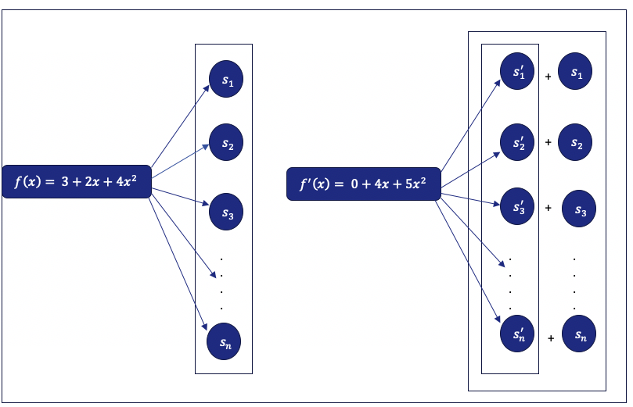
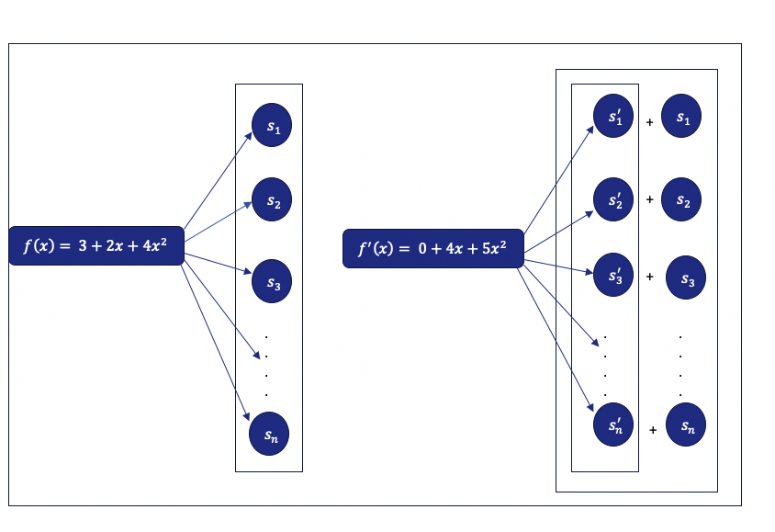

Updating Secret Key shares
Phase 2 ($f\left(x\right)+f^{′}(x)$)
Phase 1
Updating shares without changing the secret.
Updating shares without changing the private key.
Notes:
Addition of two polynomials. The new polynomial is different and shares in phase 1 cannot be used to reconstruct the secret in phase 2.

Slide 21
Conclusion
Using Password Protected Secret Sharing provides an additional layer of security as opposed to using secret sharing alone.

Slide 22
QUESTIONS

