Slide 1
Ciphertext-Policy Attribute-Based Encryption (CPABE)
Presented By
Saoreen Rahman

Slide 2
Outline
Attribute-Based Encryption
Ciphertext-policy attribute-based encryption (CP-ABE)
CPABE Construction
Security Model for CP-ABE
An application of CPABE

Slide 3
Attribute-Based Encryption
Public-key encryption
Secret key
The ciphertext
Decryption of a ciphertext is possible
set of attributes of the user key
Satisfy
the attributes of the ciphertext
Depends on attributes

Slide 4
Ciphertext-Policy Attribute-Based Encryption (CP-ABE)
CP-ABE links the access policy with the ciphertext, and attributes with the keys.
Attributes are used to describe user’s credentials
Users' secret keys set of attributes
Access policy (P) is declared by the user who encrypts data.
Access policy (P) Encryption
Secret key Decryption
User’s attribute = P

Slide 5
CP-ABE Properties
It has the capacity to address complex access control policies.
The exact list of users need not be known apriori. Knowledge of the access policy is sufficient.
CP-ABE is collusion resistance.

Slide 6







Remote File Storage: Interesting Challenges
Scalability
Reliability
Security?

Slide 7
Remote File Storage: Server Centric Access Control
Access Control List:
Alice, Bob and anyone in IT Department
Eve
IT Department,
Assistant Manager
Advantage:
Flexible Access Policies
Disadvantage:
Must trust security of server
Unwanted entity may gain the access

Slide 8


Remote File Storage: Encrypting Files
More Secure, less flexible
Needs Efficient Key distribution
Multiple file encryption with same key

Slide 9
Remote File Storage: Solution
We want
Encrypted files for untrusted storage
Offline key distribution
No Server Centric Access Control
Fine grained access policies
Solution: CPABE
User’s private key is associated with attributes
Files can be encrypted under access policy (P) over those attributes
Decryption is possible only user’s attributes pass through the ciphertext’s access policy (P).

Slide 10
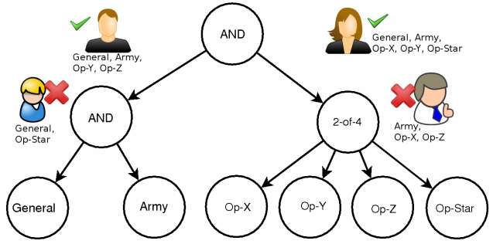
CP-ABE Example
Internal Nodes:
AND gates
OR gates
K-of-n threshold gates
Leaf Nodes: attributes

Slide 11
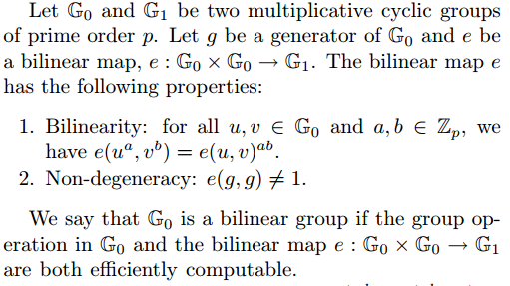
Background: Bilinear Maps
And

Slide 12
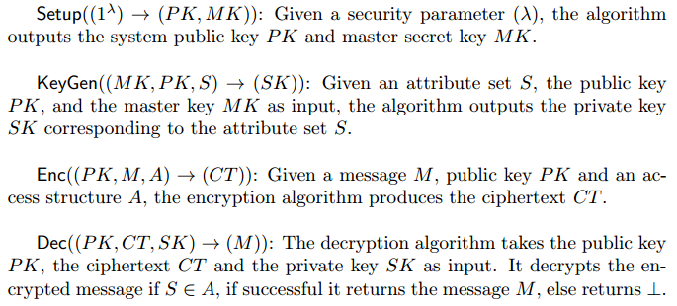
CPABE Construction

Slide 13
CPABE Construction
Public Key
Master Key
Secret Key

Slide 14

CPABE Construction
Encryption
Use general secret sharing techniques to model policy
Decryption
Uses LaGrange interpolation in the exponents

Slide 15
Collusion Resistance
A critical property for cryptographic access control systems.
An adversary that holds multiple keys should only be able to access data if at least one individual key grants access.

Slide 16
Collusion Resistance
Desired attributes:
Random Value:
Secret Key,
“Binds” key components to each other
Key to preventing collusion attacks

Slide 17
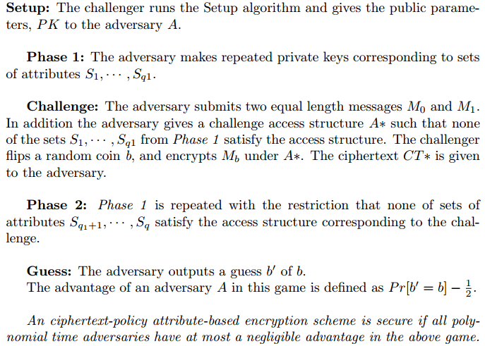
CPABE Security Model

Slide 18
The cp-abe Toolkit
cpabe-setup
Generates a public key and a master key.
cpabe-keygen
Given a master key, generates a private key for a set of attributes
cpabe-enc
Given a public key, encrypts a file under an access tree specified in a policy language.
cpabe-dec
Given a private key, decrypts a file.

Slide 19

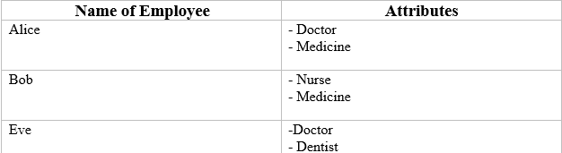
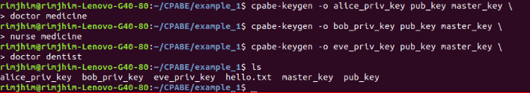
The cp-abe Toolkit
cpabe-setup
cpabe-keygen

Slide 20


The cp-abe Toolkit
cpabe-enc
cpabe-dec

Slide 21
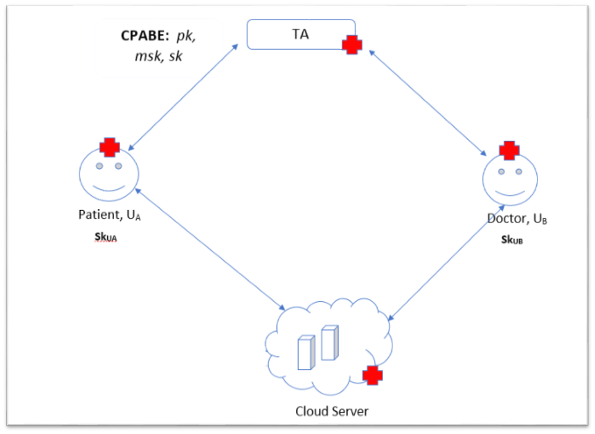
Application of CPABE: EHR System

Slide 22
Reference
[1] Sahai A., Waters B. Fuzzy Identity-Based Encryption. In: Cramer R. (eds) Advances in Cryptology–EUROCRYPT 2005. vol 3494. Springer, Berlin, Heidelberg. https://doi.org/10.1007/11426639_27.
[2] Goyal, V., Pandey, O., Sahai, A., & Waters, B. Attribute-based encryption for fine-grained access control of encrypted data. In Proceedings of the 13th ACM conference on Computer and communications security. 2006, October. pp. 89-98.
[3] Bethencourt, J.; Sahai, A.; Waters, B. Ciphertext-Policy Attribute-Based Encryption. 2007 IEEE Symposium on Security and Privacy (SP '07). pp. 321-334. doi:10.1109/SP.2007.11. ISBN 978-0-7695-2848-9.
[4] J. Bethencourt, A. Sahai, and B. Waters. The cpabe toolkit. http://acsc.csl.sri.com/cpabe/

Slide 23

Thank You

Slide 24
Appendix
Access Tree, (Access Structure)
Each non-leaf node of the tree represents a threshold gate
is the number of children of a node
is the threshold value where
is an OR gate
is an AND gate
Access Tree, (Policy Check)
If a set of attributes, S satisfies the access tree
returns iff

Slide 25
Appendix
Shamir's secret sharing scheme
Start with root node (R)
Calculate for each node.

Slide 26
Appendix
LaGrange interpolation

