Slide 1
Zero-knowledge Proofs: An Introduction
Mamunur Akand

Slide 2

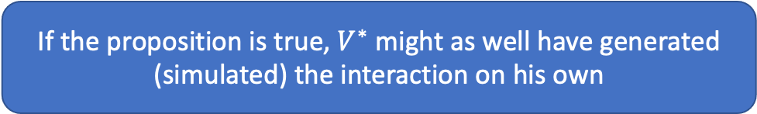
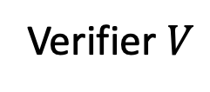
Zero-knowledge proofs
A high-level Idea
How it all started
Prover $P$
Verifier $V$
What if Verifier is untrusted in an interactive proof? [GMR’85]
$P$ interacts with $V$ convincing him that a proposition is True
[GMR’85] S. Goldwasser, S. Micali, and C. Rackoff. The knowledge complexity of interactive proof-systems. In Proc.v17th ACM Symp. on Theory of Computing, pages 291-304, Providence, 1985. ACM.
Interaction reveals nothing beyond the validity of the proposition
Presentation outline
If the proposition is true, $V^{∗}$ might as well have generated (simulated) the interaction on his own
Proof System
Interactive Proof System
Zero-knowledge Proof
Do not need to define “knowledge” at all!

Slide 3

Toy Example
Yes, you swapped
I can distinguish the balls
Did I swap?
Alice
Bob
Bob’s view: The “swap” bit
Bob could generate (simulate) this view by himself.

Slide 4
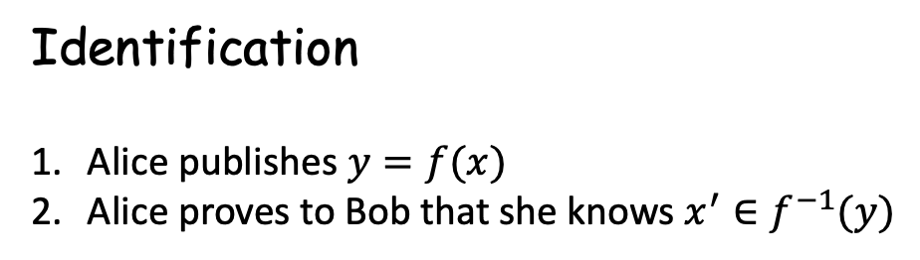
Where can we use Zero-knowledge?
Blockchain Application
Private transaction – Zerocoin
Self-sovereign identity - Sovrin
Identification
Alice publishes $y=f(x)$
Alice proves to Bob that she knows $x^{′}∈f^{−1}(y)$
Protocol Design
Firstly, design for parties that follow protocol
Then, use ZK proof to force honest behavior

Slide 5
Proof Systems

Slide 6
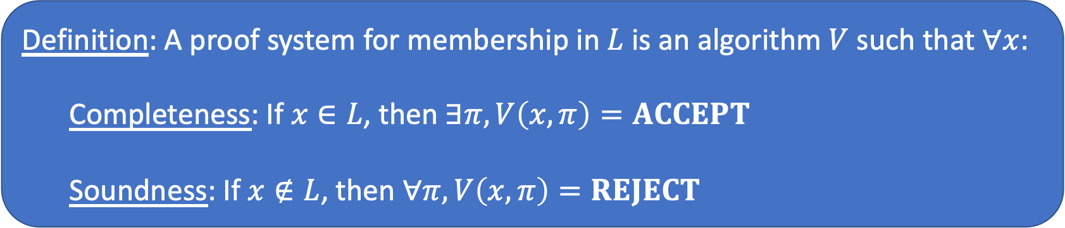



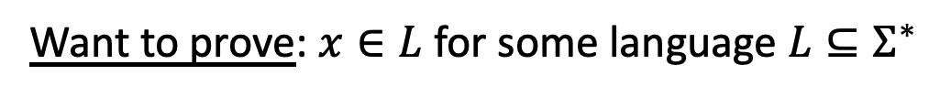

Proof Systems
What is a proof?
Want to prove: $x∈L$ for some language $L⊆Σ^{∗}$
A method for establishing truth
$$π$$
V
$$π$$
Axioms
$$→ →…→$$
Propositions
$$L=\left\{x \right|∃π,V\left(x,π\right)=ACCEPT\}$$
Probabilistic, Interactive
Definition: A proof system for membership in $L$ is an algorithm $V$ such that $∀x$:
  Completeness: If $x∈L$, then $∃π,V\left(x,π\right)=ACCEPT$
  Soundness: If $x∉L$, then $∀π,V\left(x,π\right)=REJECT$

Slide 7
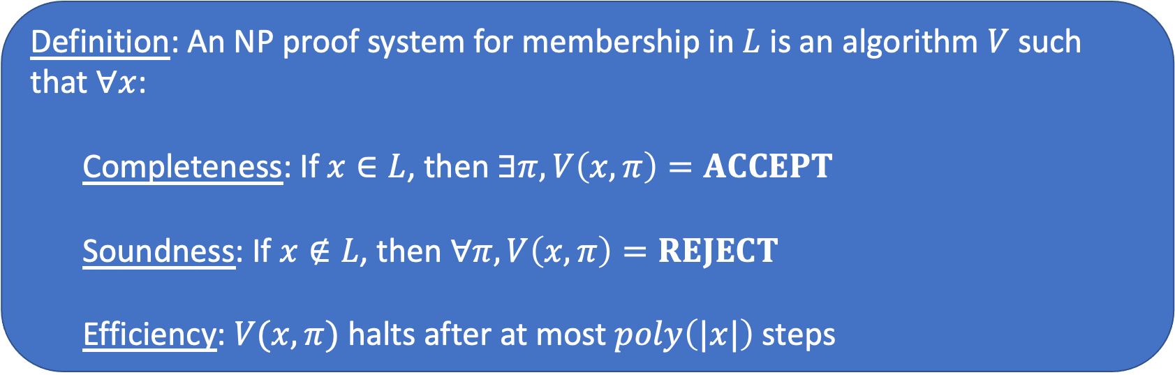
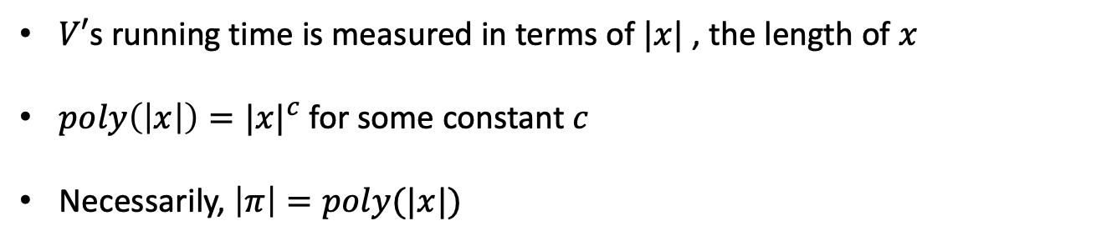
NP Proof Systems
efficient verification ⟺ poly-time verification
Definition: An NP proof system for membership in $L$ is an algorithm $V$ such that $∀x$:
  Completeness: If $x∈L$, then $∃π,V\left(x,π\right)=ACCEPT$
  Soundness: If $x∉L$, then $∀π,V\left(x,π\right)=REJECT$
  Efficiency: $V(x,π)$ halts after at most $poly\left(|x|\right)$ steps
$V′$s running time is measured in terms of $|x|$ , the length of $x$
$poly\left(\left|x\right|\right)={|x|}^{c}$ for some constant $c$
Necessarily, $\left|π\right|=poly(|x|)$

Slide 8



Example: Quadratic Residuosity
$$QR_{N}=\left\{x \right| x is a quadratic residue mod N\}$$
$$π=w$$
V
?
$$x∈QR_{N}:$$
$$x ≡w^{2} mod N$$
[GMR’85]: allow proof to use
• Randomness (tolerate “error”)
• Interaction (add a “prover”)

Slide 9
Interactive Proofs

Slide 10
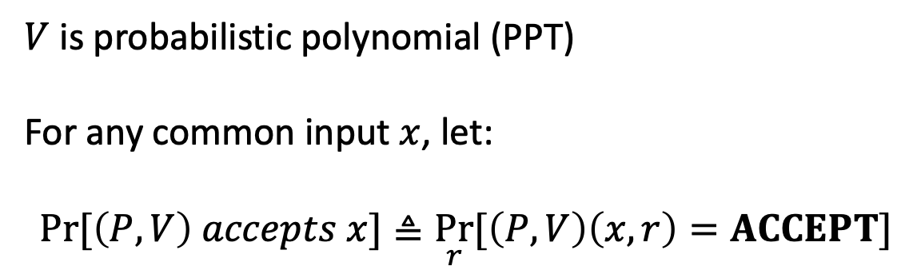






Interactive Proof
P
V
$$x∈ L$$
$$m_{1}$$
$$r∈_{R} {\left\{0,1\right\}}^{poly\left(\left|x\right|\right)}$$
$$m_{2}$$
$$⋮$$
$$m_{k}$$
ACCEPT/REJECT
$V$ is probabilistic polynomial (PPT)
For any common input $x$, let:
$$Pr⁡[\left(P,V\right) accepts x]≜\underset{r}{Pr}{[\left(P,V\right)\left(x,r\right)=ACCEPT]}$$

Slide 11
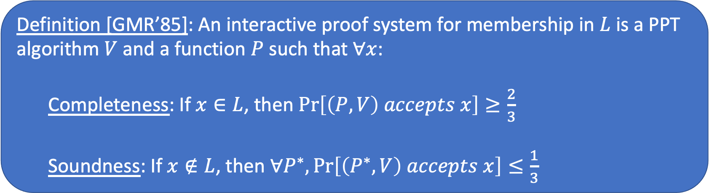
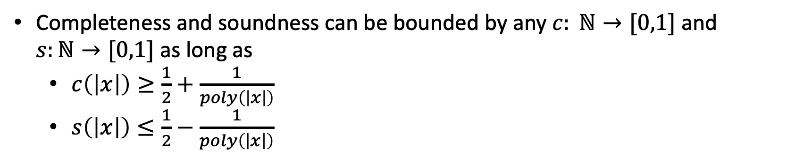
Interactive Proof Systems
Definition [GMR’85]: An interactive proof system for membership in $L$ is a PPT algorithm $V$ and a function $P$ such that $∀x$:
  Completeness: If $x∈L$, then $\operatorname{Pr}\left[\left(P,V\right) accepts x\right]≥\frac{2}{3}$
  Soundness: If $x∉L$, then $∀P^{∗},\operatorname{Pr}\left[\left(P^{∗},V\right) accepts x\right]≤\frac{1}{3}$
Completeness and soundness can be bounded by any $c: ℕ→[0,1]$ and $s:ℕ→[0,1]$ as long as
  $c\left(\left|x\right|\right)≥\frac{1}{2}+\frac{1}{poly\left(\left|x\right|\right)}$
  $s\left(\left|x\right|\right)≤\frac{1}{2}−\frac{1}{poly\left(\left|x\right|\right)}$

Slide 12
Zero-knowledge

Slide 13
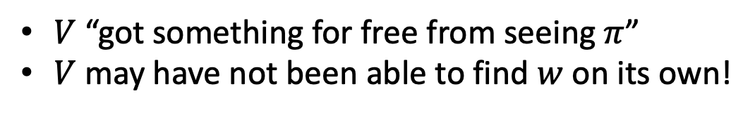
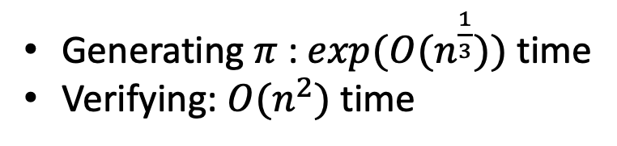
A Proof that leaks knowledge
$$QR_{N}=\left\{x \right| x is a quadratic residue mod N\}$$
$$π=w$$
V
?
$$x∈QR_{N}:$$
$$x ≡w^{2} mod N$$
Generating $π$ : $exp⁡(O(n^{\frac{1}{3}}))$ time
Verifying: $O(n^{2})$ time
$V$ “got something for free from seeing $π$”
$V$ may have not been able to find $w$ on its own!

Slide 14
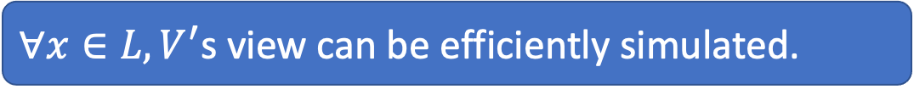
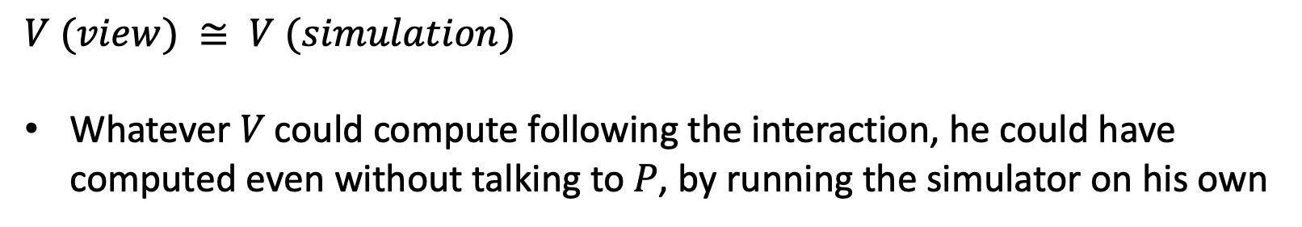
Defining Zero-knowledge
𝑉’s view = 𝑉’s random coins and messages it receives
$∀x∈L, V^{′}$s view can be efficiently simulated.
$V (view) ≅ V (simulation)$
Whatever 𝑉 could compute following the interaction, he could have computed even without talking to 𝑃, by running the simulator on his own

Slide 15
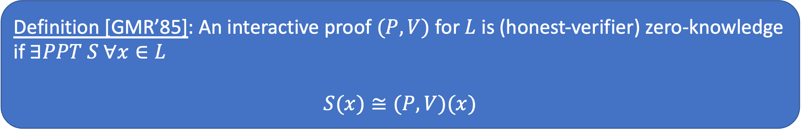
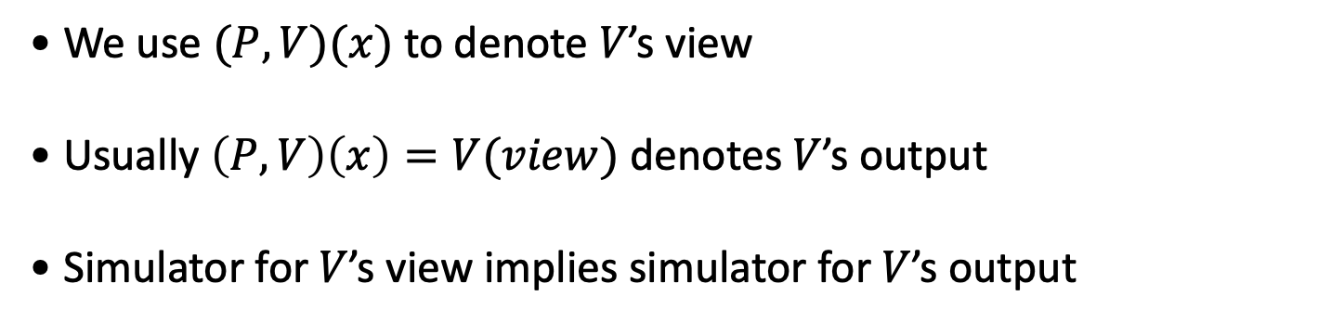
Honest Verifier Zero-knowledge
𝑉’s view distribution can be simulated in poly-time
  We will allow simulator 𝑆 to be probabilistic (𝑃𝑃𝑇)
  Efficient ⟺ Probabilistic poly-time
Definition [GMR’85]: An interactive proof $(P,V)$ for $L$ is (honest-verifier) zero-knowledge if $∃PPT S ∀x∈L$
$$S(x)≅(P,V)(x)$$
• We use $(P,V)(x)$ to denote 𝑉’s view
• Usually $\left(P,V\right)\left(x\right)=V(view)$ denotes 𝑉’s output
• Simulator for 𝑉’s view implies simulator for 𝑉’s output

Slide 16




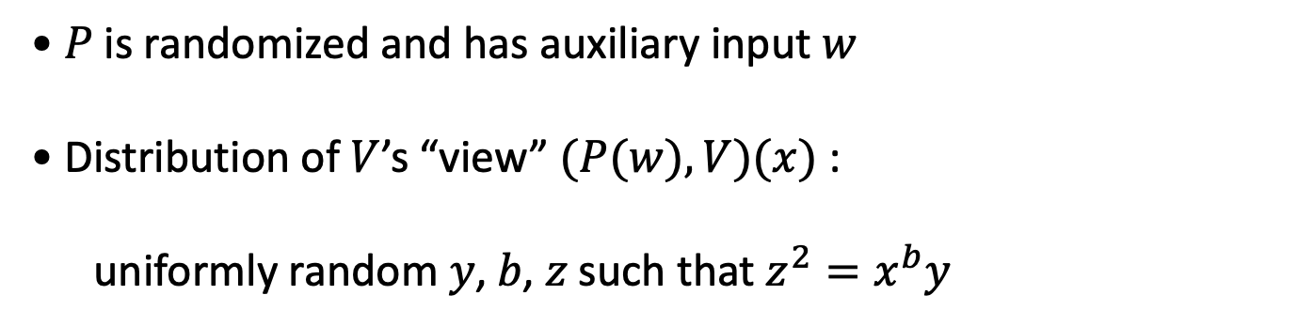
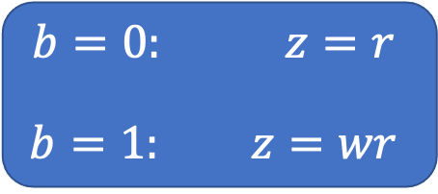



A Zero-knowledge Proof for $QR_{N}$
P
V
$$x=w^{2} mod N$$
$$x∈QR_{N}$$
$$y=r^{2}$$
$$b$$
$${b∈}_{R} \{0,1\}$$
$$b=0: z=r$$
$$b=1: z=wr$$
?
$$z^{2}=y$$
?
$$z^{2}=xy$$
• 𝑃 is randomized and has auxiliary input 𝑤
• Distribution of $V$’s “view” $(P(w),V)(x)$ :
uniformly random 𝑦, 𝑏, 𝑧 such that $z^{2}=x^{b}y$

Slide 17

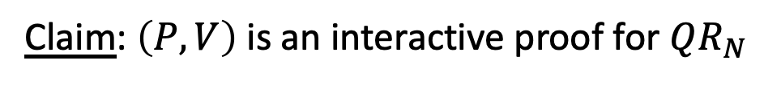

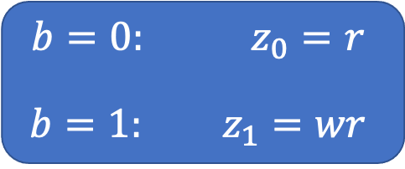

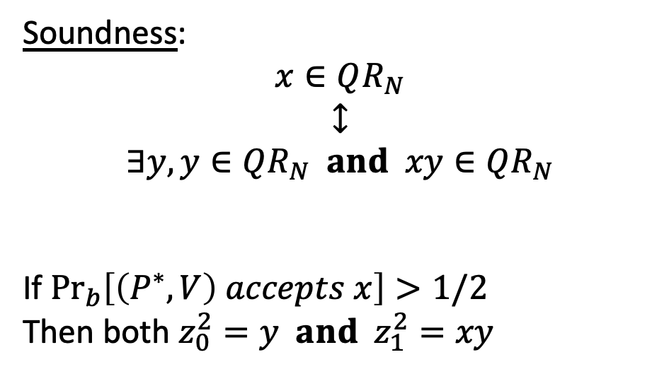


A Zero-knowledge Proof for $QR_{N}$
Claim: $\left(P,V\right)$ is an interactive proof for $QR_{N}$
P*
V
Soundness:
$$x∈QR_{N}$$
$$↕$$
$$∃y,y∈QR_{N} and xy∈QR_{N}$$
If $\underset{b}{Pr}\left[\left(P^{∗},V\right) accepts x\right]>1/2$
Then both $z_{0}^{2}=y and z_{1}^{2}=xy$
$$x∈QR_{N}$$
$$y=r^{2}$$
$$b$$
$$b=0: z_{0}=r$$
$$b=1: z_{1}=wr$$
?
$$z_{0}^{2}=y$$
?
$$z_{1}^{2}=xy$$

Slide 18
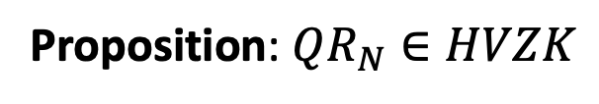

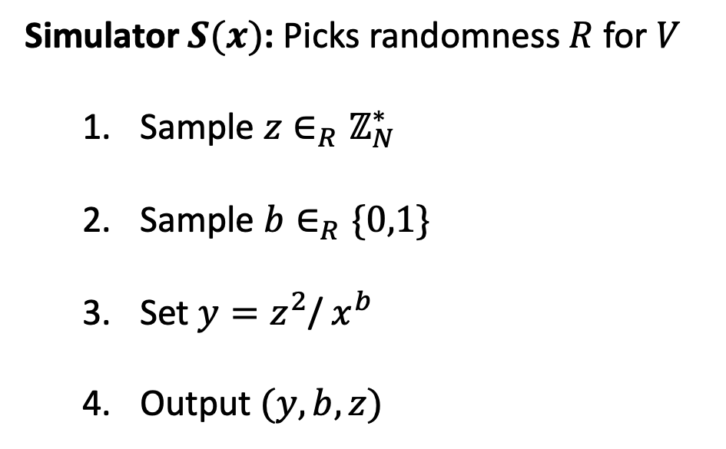


Simulating V’s view
P
V
Simulator $S(x)$: Picks randomness $R$ for $V$
  Sample $z∈_{R}ℤ_{N}^{∗}$
  Sample $b∈_{R}\{0,1\}$
  Set $y=z^{2}$/ $x^{b}$
  Output $(y,b,z)$
$$y$$
$$b$$
$$z$$
random $(y,b,z)$ such that $z^{2}=x^{b}y ≅$ random $(y,b,z)$ such that $z^{2}=x^{b}y$
Proposition: $QR_{N}∈HVZK$

Slide 19

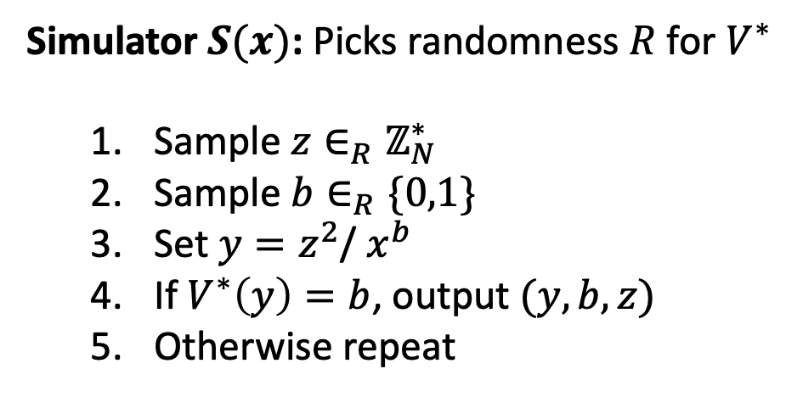
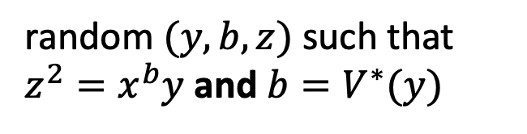
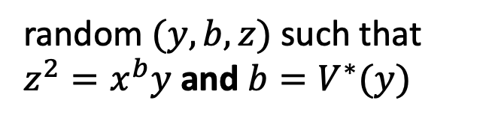


Simulating malicious V’s view
Simulator $S(x)$: Picks randomness $R$ for $V^{∗}$
  Sample $z∈_{R}ℤ_{N}^{∗}$
  Sample $b∈_{R}\{0,1\}$
  Set $y=z^{2}$/ $x^{b}$
  If $V^{∗}\left(y\right)=b$, output $(y,b,z)$
  Otherwise repeat
P
V*
$$y$$
$$b=V^{∗}(y)$$
$$z$$
$$x∈QR_{N}$$
$$↕$$
$$𝔼\left[\#repititions\right]=2$$
random $(y,b,z)$ such that $z^{2}=x^{b}y$ and $b=V^{∗}(y)$
random $(y,b,z)$ such that $z^{2}=x^{b}y$ and $b=V^{∗}(y)$
$$≅$$

Slide 20
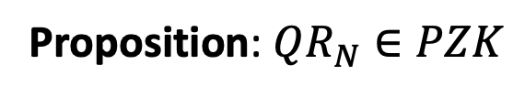
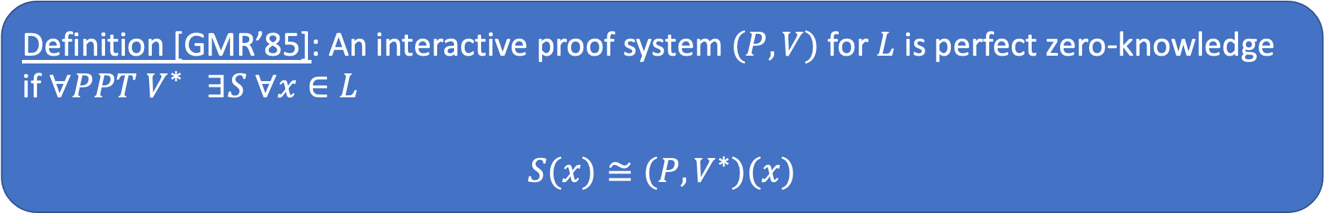
Perfect Zero-knowledge
Definition [GMR’85]: An interactive proof system $(P,V)$ for $L$ is perfect zero-knowledge if $∀PPT V^{∗} ∃S ∀x∈L$
$$S(x)≅(P,V^{∗})(x)$$
Proposition: $QR_{N}∈PZK$

Slide 21
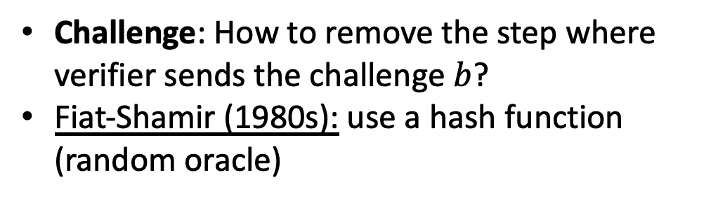
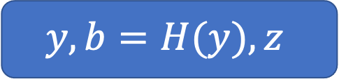



From Interactive to Non-interactive
P
V
$$y$$
Challenge: How to remove the step where verifier sends the challenge $b$?
Fiat-Shamir (1980s): use a hash function (random oracle)
$$y,b=H(y),z$$
$$b$$
$$z$$

Slide 22
Zero-knowledge Proofs of Knowledge
A proof system is a zero‐knowledge proof of knowledge if it has
  Completeness: honest prover convinces honest verifier
  Zero knowledge: ensures verifier learns nothing
  Knowledge soundness: ensures prover knows witness

Slide 23
End of Presentation
This presentation follows the structure of BIU winter school 2019 presentation on ZKP by Alon Rosen.

